Slide 1
Diagnosis of Chest X-Ray images
using Deep Convolution Network

Slide 2
Project Mentor - Prof. Hari Om
Presented By:
Avi Sahney (17JE003050)
Devashish Gupta (17JE002834)
Aditya Sharma (17JE002941)
Rohit Kumar (17JE003215)

Slide 3
Abstract
A chest X-ray is a fast and painless imaging test that uses certain electromagnetic waves to create pictures of the structures in and around your chest.
This test can help diagnose and monitor conditions such as pneumonia, heart failure, lung cancer, tuberculosis, sarcoidosis, and lung tissue scarring, called fibrosis.
The NIH recently released a chest X-Ray dataset comprising 112,120 frontal-view X-ray images of 30,805 unique patients with fourteen disease image labels, mined using NLP (natural language processing).

Slide 4
Why Deep Convolutional Networks?
Deep Convolutional neural networks have been widely used to solve computer vision problems such as image recognition and disease predictions in image data. We used a wide array of deep neural network architectures to train models for highly accurate predictions of diseases in the Chest X-Ray.
Deep learning techniques are state-of-the-art learning algorithms and perform quite well in medical image analysis. Our objective is to train models on the provided dataset to generate accurate predictions on new data and localizing the diseases in the Xray images.

Slide 5
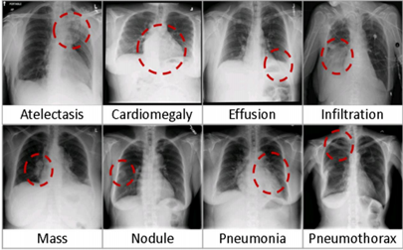
DataSet
Dataset for this project has been taken from National Institute of health.
The NIH recently released a chest X-Ray dataset comprising 112,120 frontal-view X-ray images of 30,805 unique patients.
It consists of 14 different diseases . Fourteen common pathologies include Cardiomegaly, Atelectasis, Consolidation, Infiltration, Pneumothorax, Edema, Emphysema, Fibrosis, Effusion, Pneumonia, Pleural_thickening, Nodule, Mass and Hernia.

Slide 6
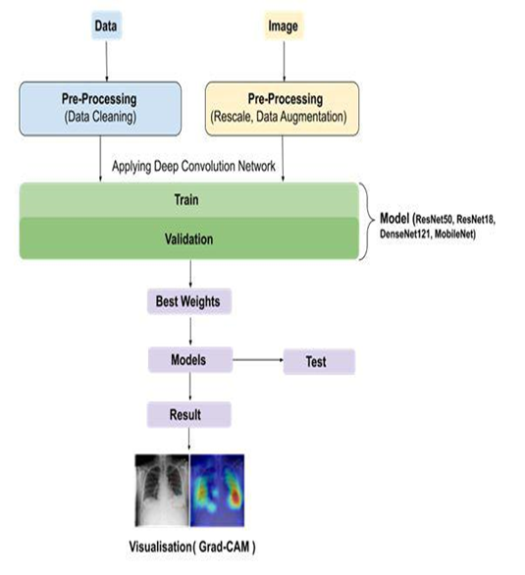
Flow-Diagram:
Timeline of our project

Slide 7
The project can be broken down into two major parts. These include :
1. Classification of diseases
2. Localization of diseases

Slide 8
Steps involved in the classification of diseases
● Data preprocessing and augmentation
● Training various models and finding the best fit for the data
● Visualizing the predictions made by the model on test dataset through measurements such as AUC ROC , and plotting the confusion matrix

Slide 9
Steps involved in the localization of diseases
Using Grad CAM or Grad CAM++ algorithms to plot the activation maps for generating heatmaps
Validating the generated heatmaps using the bounding boxes provided.

Slide 10
Data preprocessing and augmentation
The labels of the data entries were converted to categorical labels for each disease. We are using all 14 diseases in our project.
The images provided in the dataset were rescaled to images of resolution 100*100 pixels. The data augmentation was applied to the images in training data which included techniques such as horizontal flipping and shifting of images.
DownSampling of the DataSet was done.

Slide 11
Why DownSampling?
The Dataset we were using was having more than 50% images with No Findings.
We downsampled dataset by 50% using concept of class weightage.
Total number of images were reduced to 50000 from 1 lakh.

Slide 12
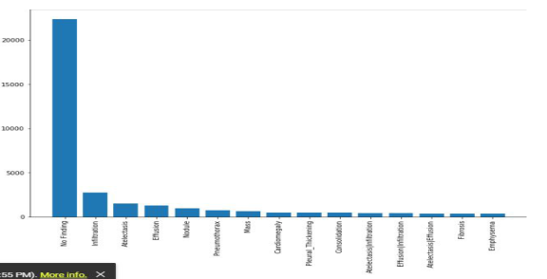
The below two histograms show the frequency of each class in the dataset before downsampling of the dataset

Slide 13
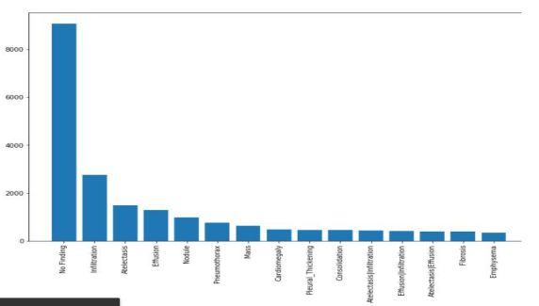
The below two histograms show the frequency of each class in the dataset after downsampling of the dataset

Slide 14
Several neural network architectures were employed for the task, these include
ResNet50 (23 million parameters), ResNet18 (11 million parameters), DenseNet121, MobileNet
We are also looking forward to train models such as GoogleNet and Inception networks as well as simple networks such as VGG16.

Slide 15
AUC ROC curve
In the metrics, we are using accuracy and a custom metric loss which evaluates the AUC score i.e area under the ROC curve.
We used the AUC ROC curve because the dataset provided is strongly biased towards the absence of diseases in the images.
This will help us to select models that have true positive and false positive rates that are significantly above random chances that are not guaranteed by accuracy alone.

Slide 16
Result - ResNet50
The first model we trained was ResNet​-50​.We used the pre-trained weights from the imagenet dataset. The top layer was removed from the model and a dense layer of 14 units was used to provide the output.
Learning-rate = 0.001 , optimizer = rmsprop (decay = 1e-6) , loss = binary cross entropy, epochs = 20

Slide 17
Result cont.
Model | Training Loss | Val. loss | Mean AUC ROC score
ResNet50 | 0.1009 | 0.22928 | 0.76

Slide 18
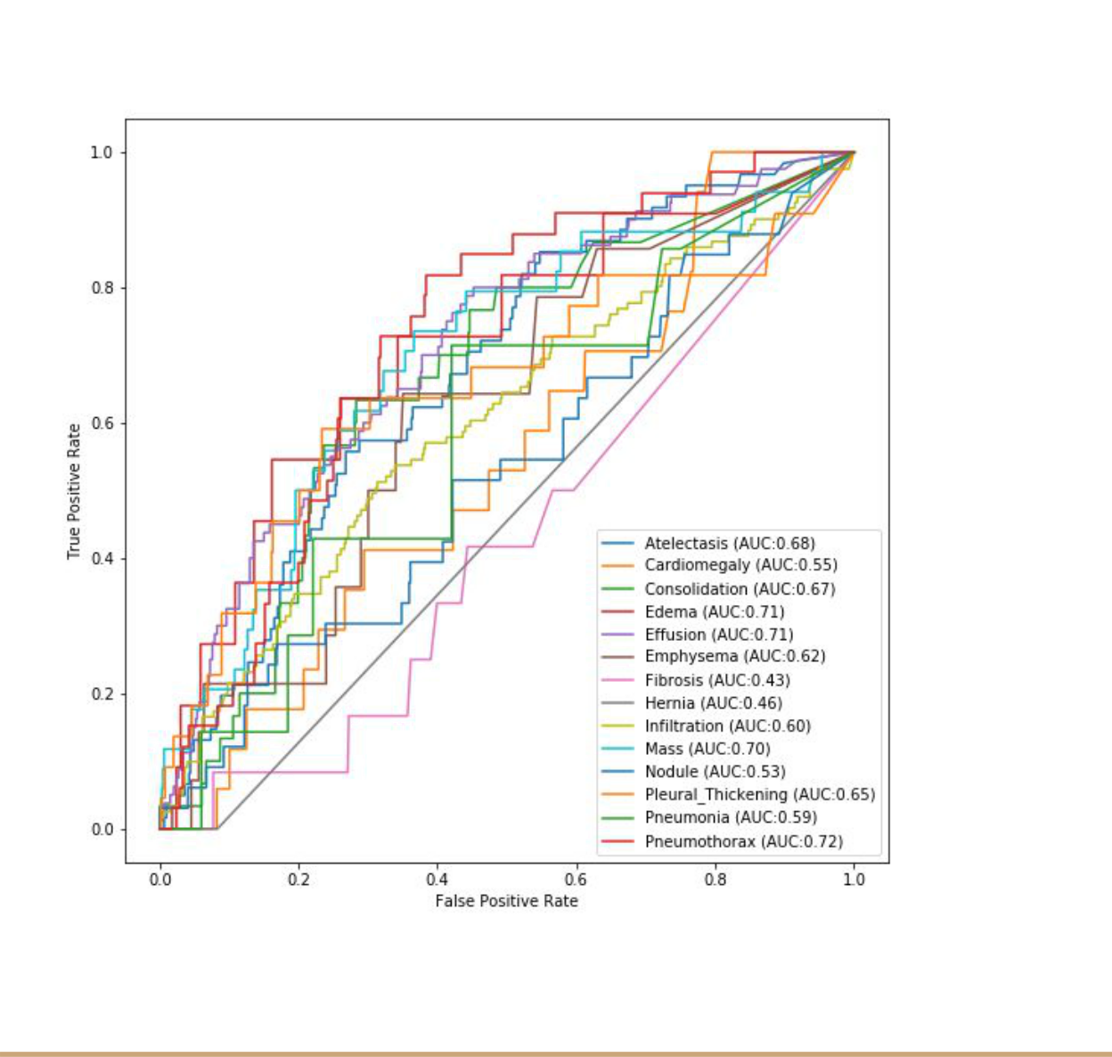
Result cont.

Slide 19
Result - DenseNet121
The result we got was not satisfactory on the test dataset. We got random predictions on the test dataset. The ratio of TP(True positive) to FP(False Positive) was very low. We suspected we might be overfitting the data on such a large neural network with almost 25 million parameters. The next model we trained was ​DenseNet121.
The pre trained weight were loaded from imagenet and the model was trained using :
Learning_rate = 0.001, optimizer = Adam, loss = binary_crossentropy , epochs = 20

Slide 20
Result contd
Model | Training Loss | Val. loss | Mean AUC ROC score
DenseNet121 | 0.1854 | 0.18556 | 0.752

Slide 21
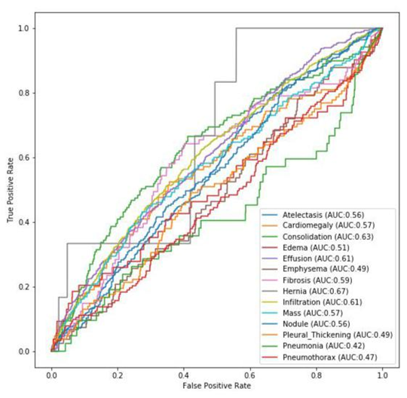
Result contd - DenseNet

Slide 22
Result cont.
The model generated similar results as ResNet50 and a very poor prediction on the test dataset . We employed a different approach to the solution by correcting few problems as given below:
We increased the size of the dataset by including more images from the dataset to stop our model from overfitting.
We trained our model with more number of epochs to train longer on the data.
We used relatively smaller models than ResNet50 but still large enough to get better results on the dataset.

Slide 23
Result - ResNet18
The next model we trained was ResNet18​​ using:
Learning_rate = 0.001 ( decreasing learning rate every time the validation loss remained the same as before by a factor of 2 with lower bound on learning rate as 0.0001),
Optimizer = Adam, number of epochs = 40, pretrained weights imported from imagenet .
The outcome of the training was better than the previous 2 models suggesting that an increase in dataset with more epochs were the right choices for the train .

Slide 24
Result cont.
Model | Training loss | Val. loss | Mean AUC ROC score
ResNet18 | 0.1606 | 0.19857 | 0.83

Slide 25
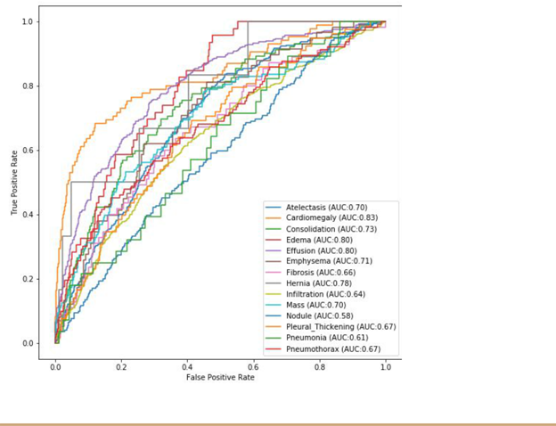
Result cont.

Slide 26

What was achieved?
Data Pre-Processing and Augmentation
We used a wide area of deep neural network architectures to train models for highly accurate predictions of diseases in the Chest X-Ray.
Visualizing the predictions made by the model on test dataset through measurements such as AUC ROC.

Slide 27
What is left?
We need to try more learning models on this data for even better results.
We haven’t done localization of disease. Will be generating heatmaps and compare them with the bounding box provided in NIH dataset.
Make a model with even high binary and categorical accuracy.

Slide 28
References
1. Rajpurkar, P., et al.: Chexnet: radiologist-level pneumonia detection on chest xrays with deep learning. arXiv preprint arXiv:1711.05225 (2017)
2. Focal loss for dense object detection. arXiv 2017 TY Lin, P Goyal, R Girshick, K He, P Dollár - arXiv preprint arXiv:1708.02002, 2000
3. Wang, Xiaosong, et al. "Chestx-ray8: Hospital-scale chest x-ray database and benchmarks on weakly-supervised classification and localization of common thorax diseases." Proceedings of the IEEE conference on computer vision and pattern recognition. 2017.

